Slide 1
MMI1060 FINANCE
Lecturer: Tanya Kirsch
Lecture 1
Introduction to the course
The Time Value of Money
(Ref: Berk Ch. 3.3, 3.4 and Ch. 4)

Slide 2
Objectives for today’s lecture
Introductions – “Hello”
Review the course outline
Introduce you to the “big ideas” of the course
Introduce one of the cornerstones of Finance:
- “The time value of money”

Slide 3
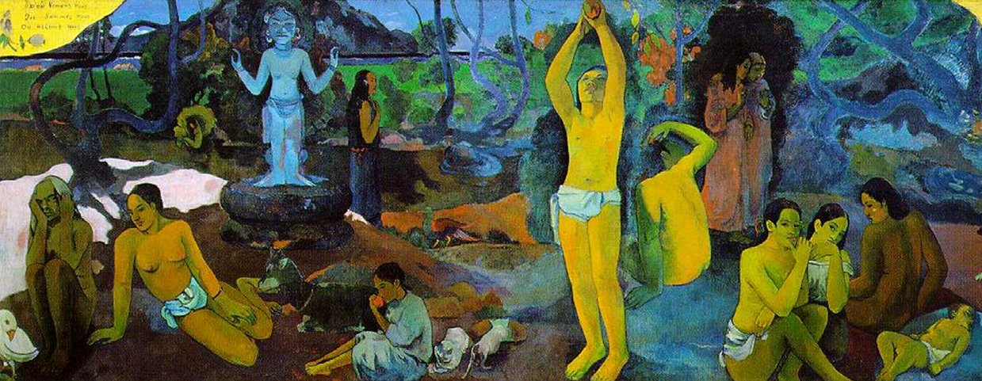
Where do we come from? What are we? Where are we going? (Paul Gauguin, 1897)

Slide 4
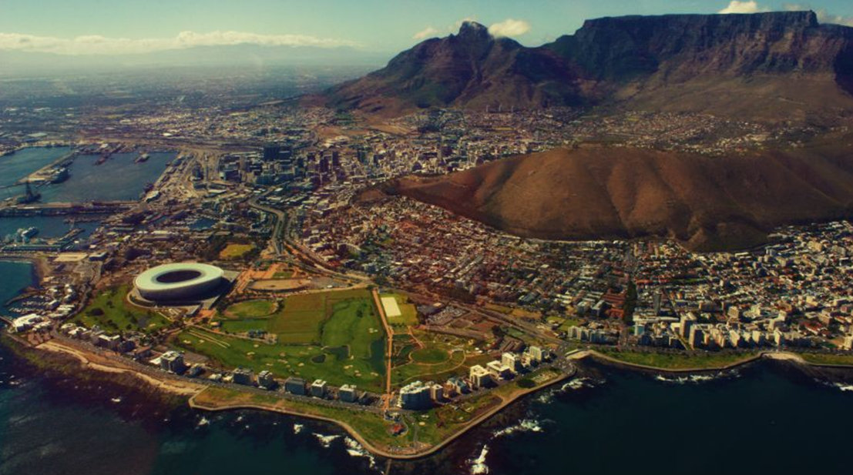
Where do we come from?

Slide 5

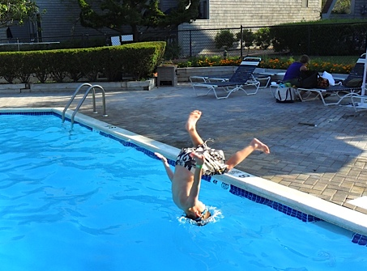
What are we?

Slide 6
Course outline
Class schedule
Textbook
Financial calculator
Tutorials
Tests
Quiz 1
Midterm
Quiz 2
Final
Notes:
Office hours are by appointment but she is only here on Thursdays unless we ask her afterwards
The tutorial is on 4:00
Fundamentals of corporate Finance
Quiz will be during the tutorial
Final exam is cumulative

Slide 7
Expectations
You are expected to read between lectures, and do the recommended problems (at a minimum)
The course moves quickly, and the first few classes are critical for your foundation in the course

Slide 8
What is Finance?
Finance seeks the answer to the following:
Capital budgeting:
What long-term investments in projects / products / companies… should I make?
Capital structure:
How should I fund my investments? (Debt, Equity?)
How much working capital should I have?
Notes:
You have a company and you will be investing in different projects like R&D
OR you may buy another company (mergers and acquisitions)
OR maybe you already have a successful drug but you want to make more or it so you invest in new equipment
How does a company decide which product to invest in
My cash out flow is 100,000,000 what will my cash inflows be in the future and which one has the greater net value today once I take off all of my expenses
Capital budgeting
Capital is how much funds do I have to use to invest in these big long term projects
Where does my money come from?
Borrowing money (debt)
Or you can sell shares (equity) – profit counts as equity
Equity lasts forever
Debt in these terms is long term debt
Companies also operate on a day to day basis
Capital budgeting is the decisions we make on which long term projects to invest in
Capital structure is saying we have capital in the company and what is the structure of it. What is the balance with debt and equity
Day to day operations is working capital

Slide 9


Slide 10
Time value of money

Slide 11
“Compound interest is the eighth wonder of the world. He who understands it, earns it ... he who doesn't ... pays it.”
Albert Einstein

Slide 12

The Pomodoro Technique ®
Notes:
- a period of time when you are focusing and that is 28mins and then you have to take a break

Slide 13
Time Value of Money: Where are we headed?
You have a string of regular payments:
What are they worth in today’s money?
What are they worth in the future?
What about if the payments happen at the beginning of a month? Or at the end of a month?
What happens if the interest rates change? And what about compounding interest?
What happens if payments are weekly instead of monthly?
What happens if payments continue forever?
What happens if the payments increase steadily? Or change?
Notes:
Time value of money
The power of compounding
Fi you want to retire in 30 years how much do you need to invest every month to get 1M.

Slide 14
Time Value of Money: Where are we headed?
To be able to calculate the Present Value and Future value of a stream of cash flows, at any point in time, and with any combination of the following characteristics:
Ordinary annuity and Annuity due
Perpetuity
Growing annuity and Growing perpetuity
Effective interest rates for a Quoted rate, where interest is compounded other-than-annually, and payment periods are not equal to the interest rate compounding period
Notes:
- Annuity are when your payments are the same every year for a fixed time

Slide 15
Problem #1: A simple example – Future Value (FV)
You invest $100 today in a bank account that pays you interest of 8% per year
What is the $100 worth in 1 year’s time?
What is the $100 worth in 5 years’ time?

Slide 16
Future Value and Present Value
The General formula:
Where:
FV = Future Value
PV = Present Value
r = Interest rate / Discount rate / Cost of capital / Required return
t = number of periods
We rearrange this formula to solve for PV, r or t
FV = PV x (1+r)^{t}

Slide 17
Handout: Final exam formula sheet

Slide 18
Level Cash Flows: Perpetuities & Annuities.
Annuities: Cash flows of equal amount every period for a limited number of periods.
Example: Loan payments for automobile, periodic earnings from lottery wins, etc..
You can use a financial calculator for annuity examples
like this
This is the formula for an ordinary or regular annuity – i.e. it gives you the present value of an annuity where payments are at the end of each period
Notes:
*5:00
Annual interest rate and annual payments are matched for us
Annuity example is loan payments for a car, or mortgage payments, or lottery win 1M right now or $2000 per week for the rest of your life (it’s a time value of money problem), pension (how much to save every month for the next 30 years to get to your goal).
PV of annuity is the value of annuity today assuming your cash flows happen at the end of each period
Assume that your first cash flow is happening at the end of the year
C is what the cash flow is
R is t he interest rate
OR you are saving up money now and want to know how much its going to be worth in the future
Example of annuity

Slide 19
Annuities
Two broad categories of problems:
Examples can be annuities where you are saving up a fixed amount every month (e.g. saving for retirement), or
Examples can be where you are paying off a loan with a fixed amount every month (e.g. an amortizing loan)
….many other examples

Slide 20
Problem #3: Basic problem (Booth 4th Ed. Ch 5, Q 30 - modified
Mary‐Beth is planning to live in a university residence for three years while completing her degree.
The annual cost for food and lodging is $6,500 and must be paid at the end of each school year. What is the total present value of Mary‐Beth’s residence fees if the discount rate (interest rate) is 6 percent per year?
NB: Start by doing a diagram to show the cash flows

Slide 21
Mary-Beth problem cont.
Using Q30 (Mary-Beth), calculate the following:
As an alternative, Mary-Beth is offered the option of paying a lower amount in her first year of $6,250, and then increasing her payment by 5% each year. Would she take this option?
Notes:
This is a growing annuity
You start with a payment and then your payments increase every year

Slide 22
Growing (or Shrinking) Annuities
A growing annuity: Payments grow at a constant rate each period, for n periods
You can use this formula for both growing and shrinking annuities
You need to use the formula (not a financial calculator) for these examples
Notes:
Shrinking k-g turns into k- - g which ends up being k+g

Slide 23
Mary-Beth cont.:
Using Q30 (Mary-Beth), calculate the following:
How would the PV of her costs change if she had to make her payments at the beginning of each year?
For the annuity
For the growing annuity

Slide 24
Ordinary Annuity vs Annuity Due
A level stream of payments starting immediately is known as an annuity due.
You calculate the PV or FV of an annuity due using the ordinary annuity formula, and then adjusting for the additional time period.
Also, your financial calculator can handle ordinary annuities / annuities due through using the end / begin modes
Notes:
- When your payments are at the beginning of every period

Slide 25
Key formulae (from the Quiz 1 formula sheet)

Slide 26
Homework: In-class problem for next week
Find the PV and FV (in 10 years from now) of a growing annuity with payments of 100 in 1 year, growing at 8% for 9 more years (i.e. 10 payments in total), if the relevant interest rate is 6% per year.
What if the payments were at the beginning of each year?
Hint: Draw a timeline to help you understand the question!
Hand in your timeline and your answer to this problem at the beginning of class next week – for a lucky draw!!

Slide 27
Perpetuities
Perpetuities: Cash flows of equal amount every period for an unlimited number of periods.
Example: Property tax payments, preferred stocks, etc..

Slide 28
Growing Perpetuities
The present value of a constant growth perpetuity:
Equation holds only when k > g, the discount rate is greater than the growth rate. Otherwise, the answer is becomes negative and has no practical interpretation.
Note that g can be > k in a growing annuity calculation (unlike the perpetuity calc)
Only future estimated cash flows and estimated growth in these cash flows are relevant, while past cash flows are not.

Slide 29
In-class Problem #4: Growing / Shrinking Perpetuity
Shirley has been offered two perpetuities: Grow and Shrink.
Grow promises her $100 at the end of this year, followed by an annual cash flow that will increase by 4 percent per year forever.
Shrink promises her $1,000 at the end of this year, but the annual cash flow will decline by 2 percent forever.
If her opportunity cost is 5% per year, which perpetuity has the greater value?
Source: Booth, 4th Ed, Ch 5, Q44

Slide 30
Recap of today’s lecture
To be able to calculate the Present Value and Future value of a stream of cash flows, at any point in time, and with any combination of the following characteristics:
Annuities; Ordinary, Growing and Annuity due
Perpetuity and Growing perpetuity
Next week:
Effective interest rates for a Quoted rate, where interest is compounded other-than-annually, and payment periods are not equal to the interest rate compounding period

Slide 31
Objectives for today’s lecture
Introduce you to the “big ideas” of the course
Review the course outline
Introduce Time Value of Money, and build on previous knowledge of the general “Future Value” formula
Annuity
Growing annuity

Slide 32
Homework
Do the relevant recommended problems (list will be posted on Quercus)
Do the homework problem that will be taken up in class next week

Slide 33
Forthcoming attractions
Next week:
Lecture: Continue with TVM, and do some additional in-class examples
Tutorial #1 (Thurs, Sept 19 @ 4pm): Additional TVM problems
Quiz 1:
Thurs, Oct 10 @ 4pm (during tutorial timeslot)

